Slide 1
Crime Scene Investigation: Glass Identification

Slide 2
Audience and Hypothesis
Audience: Law Enforcement
Hypothesis: Correctly identifying glass at a crime scene can provide evidence to be used in solving the crime.

Slide 3
UCI Glass Identification Dataset
214 Instances with 10 attributes
Attribute Information: 1. Id number: 1 to 214 2. RI: refractive index 3. Na: Sodium (unit measurement: weight percent in corresponding oxide, as are attributes 4-10) 4. Mg: Magnesium 5. Al: Aluminum 6. Si: Silicon 7. K: Potassium 8. Ca: Calcium 9. Ba: Barium 10. Fe: Iron 11. Type of glass

Slide 4
Types of Glass
Building Windows (2 types)
Vehicle Windows (2 types)
Containers
Tableware
Headlamps

Slide 5
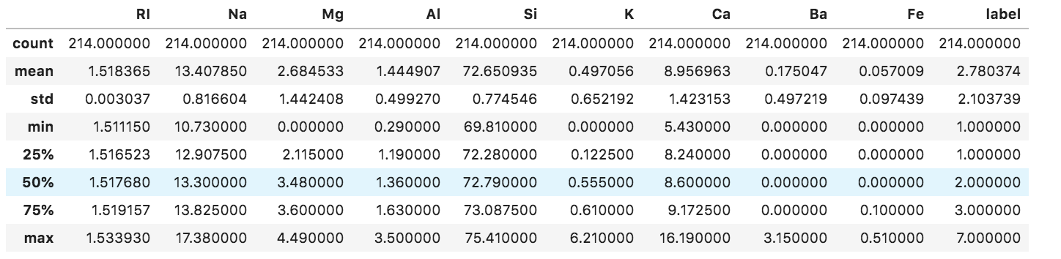
Data Wrangling

Slide 6
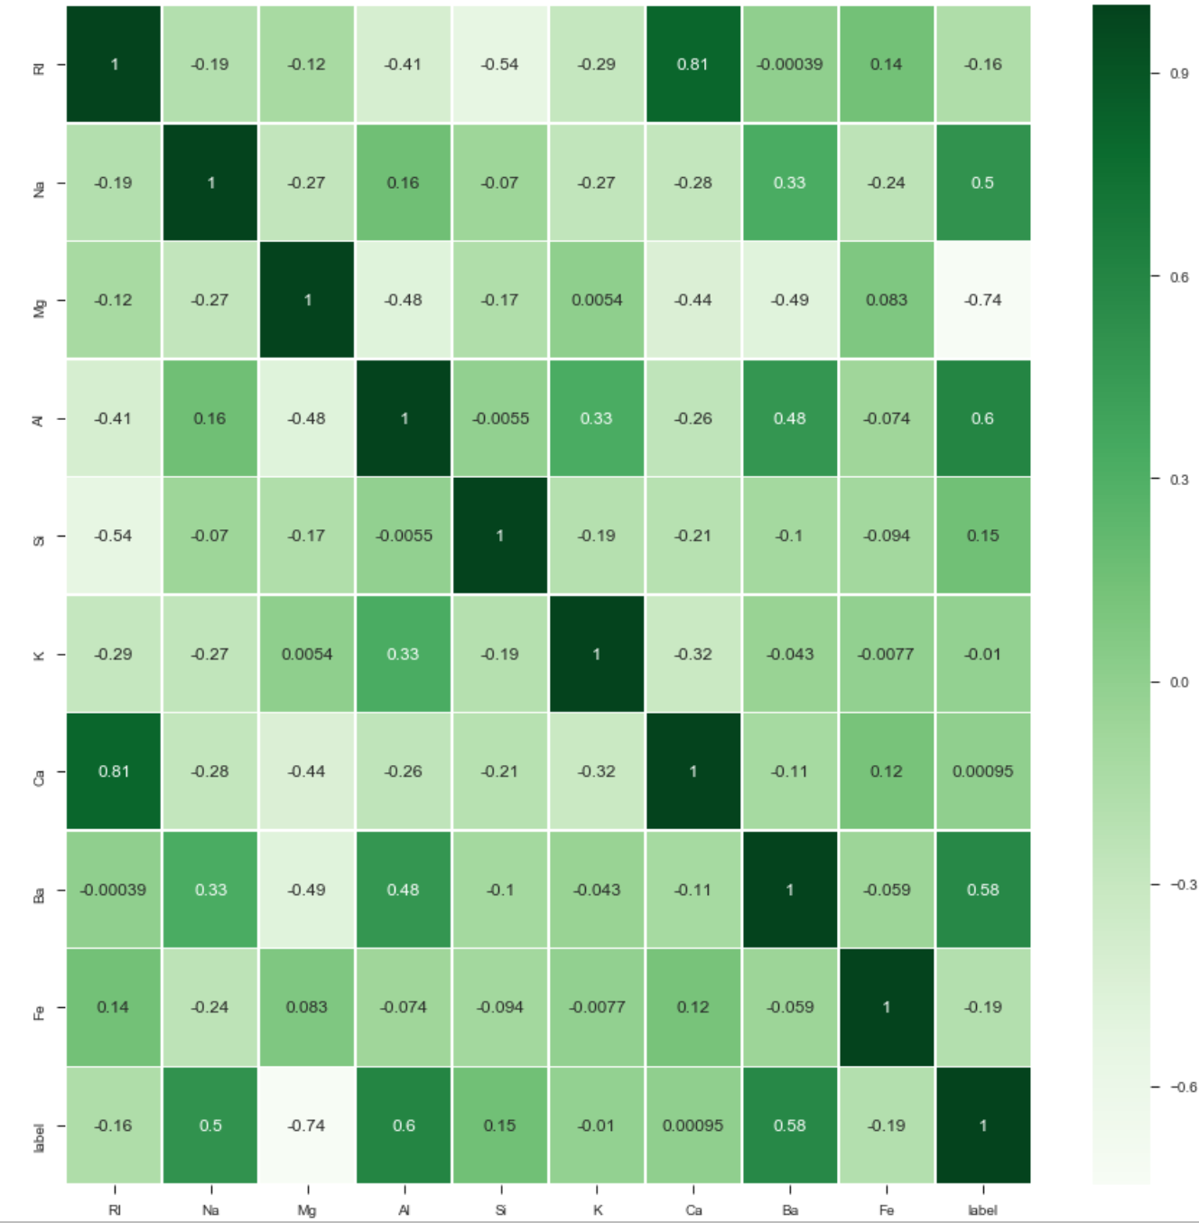
Correlation

Slide 7
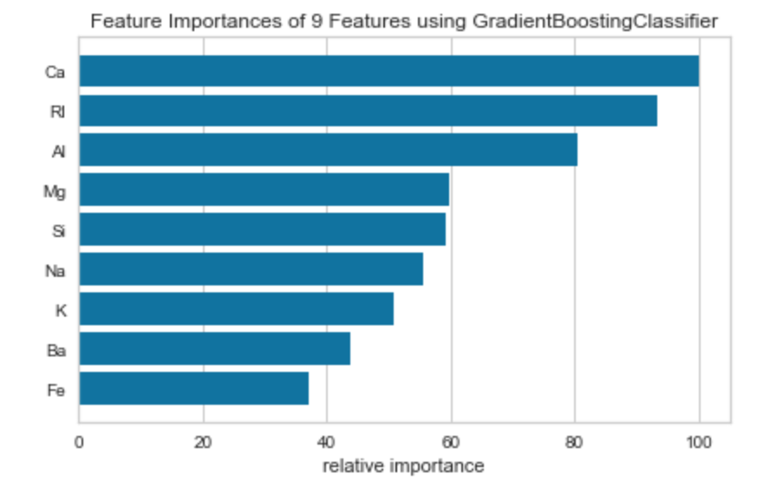
Feature Selection

Slide 8
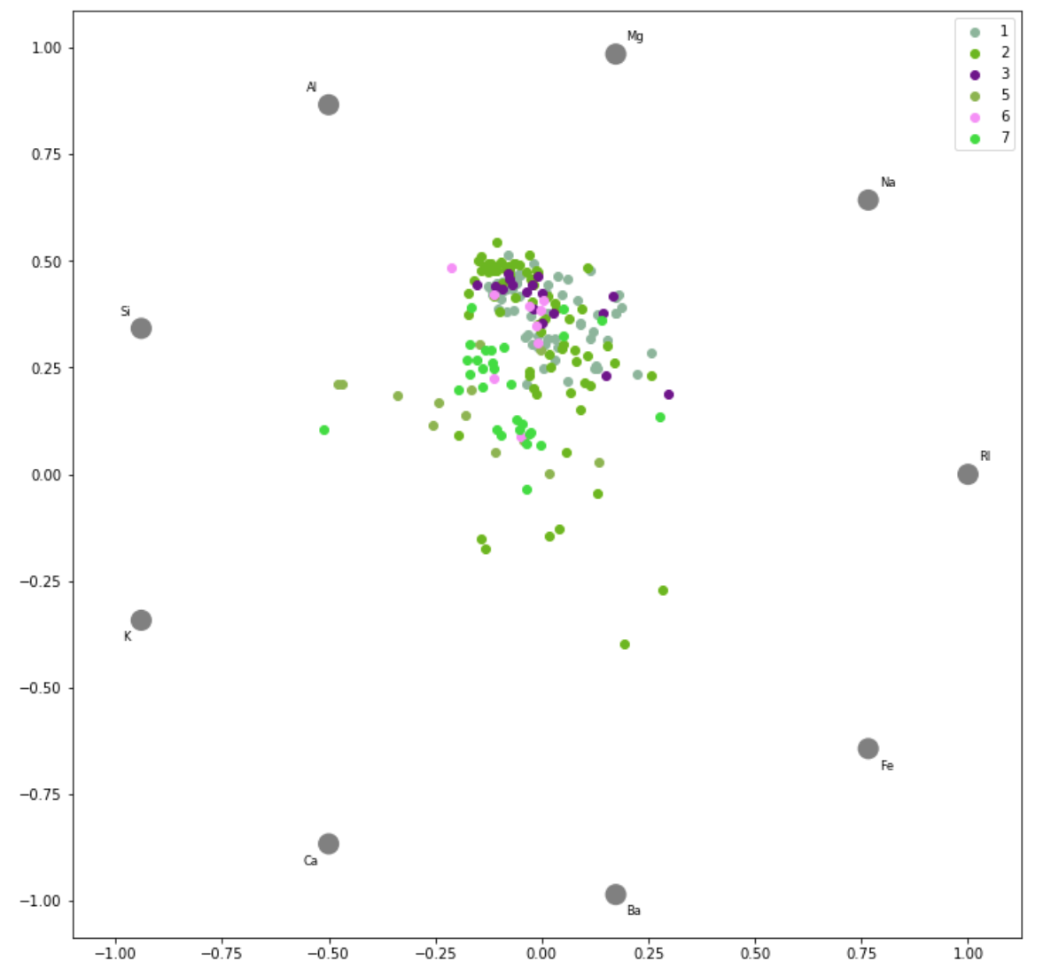
Classification

Slide 9
Model Selection
Cross Validation - train and test groups (80/20)
Run data through several algorithms to determine best fit

Slide 10
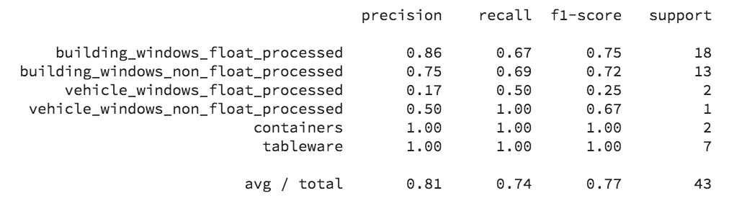
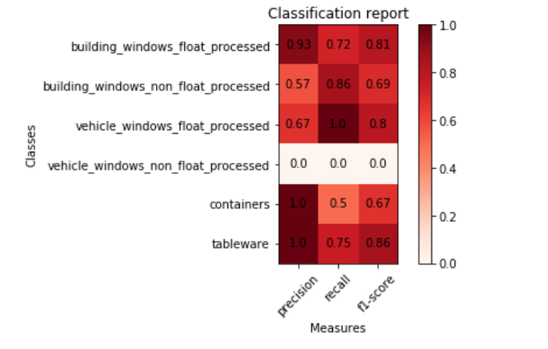
Computation and Analysis
Random Forest Classifier

